Slide 1
Introduction to JavaScript

Slide 2
Learning Outcome
After this lesson you will understand what JavaScript is and what it can be used for.
You will have an understanding on how JavaScript fits into a modern Web Application.
You will be able to create a JavaScript file and tie it to a HTML file.
You will be able to understand the flow of execution in JavaScript.

Slide 3
Agenda
JavaScript Introduction
Creating a JavaScript file
Running a JavaScript file
Exercises

Slide 4
Language overview
Introduction to JavaScript

Slide 5
Language Overview
Java and JavaScript has absolutely nothing to do with each other.

Slide 6
Language Overview
Java is to JavaScript
What Car is to Carpet

Slide 7
Language Overview
Java and JavaScript are both programming languages
They both use the Word ”Java”
Both came out of the web technology explosion in the 1990
They are both frequently encountered in the context of web browsers.

Slide 8
Language Overview
JavaScript was created in 1995 by Brendan Eich while he was an engineer at Netscape.
JavaScript was first released with Netscape 2 early in 1996. It was originally going to be called LiveScript, but it was renamed in an ill-fated marketing decision that attempted to capitalize on the popularity of Sun Microsystem's Java language — despite the two having very little in common
This has been a source of confusion ever since.

Slide 9
Language Overview
Netscape submitted JavaScript to ECMA International, a European standards organization, which resulted in the first edition of the ECMAScript standard that year.
ECMAScript edition 5 was released in 2009
ECMAScript edition 6 was released in 2015
ECMAScript is the base for what we know as JavaScript.
We will use ECMAScript and JavaScript interchangeably.
This course will be focusing mainly on ES6

Slide 10
Language Overview
JavaScript is a language that runs in the browser.
JavaScript is stored in a file with the .js extension
JavaScript is not compiled it is an interpreted language.
This means that you change the file, and reload the browser, and everything is re-run.
JavaScript execution follows the browser and is run in the context of the browser and the single page.

Slide 11
Javascript is client side
Introduction to JavaScript

Slide 12
JavaScript is client side
Javascript is a client side language, this means that the javascript is being run in your own, local browser (the users browser).
This means that you do not have access to disk, or anything on the server.
This is the same case for HTML, CSS etc.
Note: This is a very common pitfall – also for exam.

Slide 13
Creating a JS File
Introduction to JavaScript

Slide 14
Creating a JS File
JavaScript can be run either inside a HTML file
JavaScript can also be run as an external JS file
The <script> tag is used to tell the browser to load the script.

Slide 15
Exercise - Creating a JS file
Create a new HTML file (index.html)
Create the appropriate HTML Structure
In the body add a <script> tag with the corresponding </script> tag
Inside the script tag write an alert.
alert(”Hello World”);
Test it by running the HTML page

Slide 16
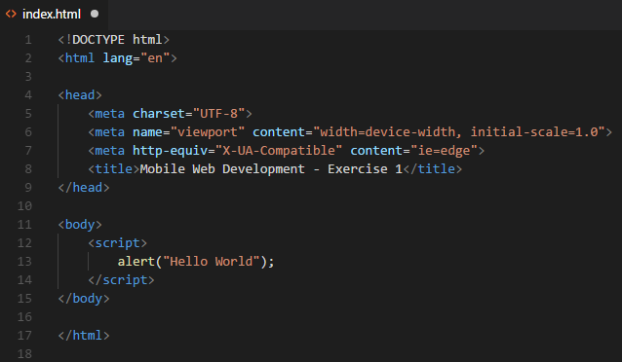
Exercise - solution

Slide 17
Using javascript
Introduction to JavaScript

Slide 18
Using Javascript
Javascript can be used for many things.
From the most basic validation to more advanced SPA systems.
Traditionally Javascript was only used to perform simple client side validations etc.
In this course we will be looking into how we can build an entire, modern web application using Javascript.

Slide 19
Using Javascript
When the Javascript file is being loaded, the content of the file is ”executed”.
HTML files and Javascript files are executed sequentially – this means that you can only refer to functions or DOM elements that has already been interpreted/compiled/processed.
That means that if the file is referred in the top of the document it will be ”executed” immediately.

Slide 20
Javascript functions
Introduction to JavaScript

Slide 21
Javascript Functions
Functions in Javascript are easy to recognise, they are very similar to what we have seen before.
A function in Javascript uses the ”function” keyword
Invoking a function is done by using the name of the function followed by paranthesis.

Slide 22
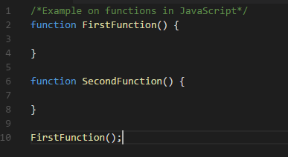
Using Javascript
Notes:
The secondfunction is never being executed. The interpreter still know about it but it is never being executed. The FirstFunction() is being run because we invoke the method. This is a sequential process (talk about function hoisting?)
https://medium.freecodecamp.org/function-hoisting-hoisting-interview-questions-b6f91dbc2be8
Funktioner er objecter → First-class citizenship, within the world of programming, means that a given entity (such as a function) supports all the operational properties inherent to other entities; properties such as being able to be assigned to a variable, passed around as a function argument, returned from a function,
Functions = objects

Slide 23
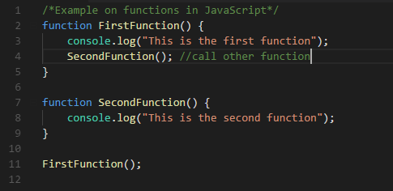
Using JavaScript

Slide 24
Using Javascript
A JavaScript file is made up from functions.
A function is not executed unless there is a explicit call for that function.
Javascript has all the constructs we know from C#/Java – if, for, while, etc.
Always remember that we are on a client so for good reason there are some features that we dont have direct access to (like files – which files?)

Slide 25
Using Javascript
One of the common tasks in Javascript programming is interacting with the HTML document.
From Javascript we can always get a reference to HTML elements and change them from code (like labels in C#/Java)

Slide 26
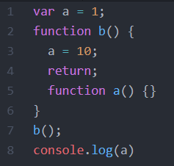
Using JavaScript
What is the output?
Notes:
1

Slide 27
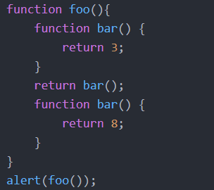
Using JavaScript
What is the output?
Notes:
8

Slide 28
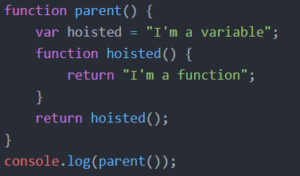
Using JavaScript
What is the output?
Notes:
“TypeError: hoisted is not a function”

Slide 29
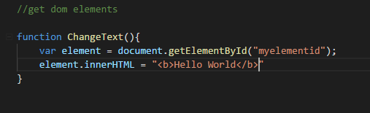
Using Javascript
It is common practice to refer to different DOM elements from Javascript.

Slide 30
Using Javascript
For this JavaScript (previous slide) to work the element need to be loaded at this point.
That means that if this Javascript is being EXECUTED in the beginning of the document, that element might not have been created in the DOM yet.
That would give an error.
Solution: Place the load of JavaScript in the bottom of the page, to be loaded as the last thing.

Slide 31
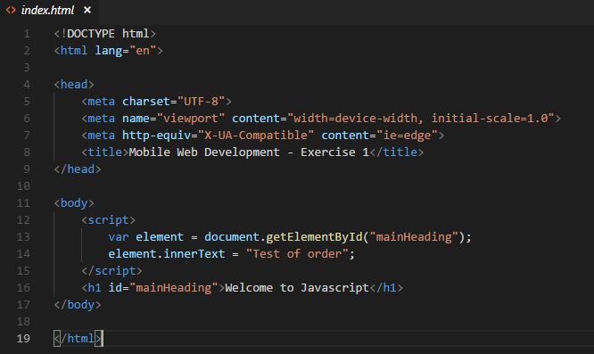
Using Javascript
Notes:
What will happen here?
! It will fail – how do we see the error?

Slide 32
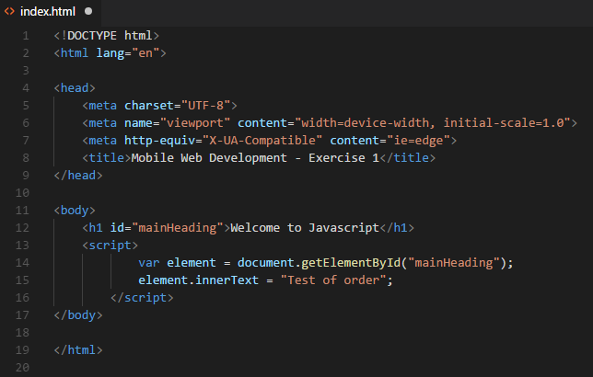
Using Javascript
Notes:
Or we could use defer

Slide 33
exercises
Introduction to JavaScript

Slide 34
Exercises
Create a new HTML file
Create a script tag and make an alert with some text.
Create a new JS file and move the code to the new file.
Figure out how to refer to an external JS file using the script tag.
Try changing the JS code and reloading the HTML page and see that nothing compiles, everything is run immediately.
Test that you can log to the debug log: console.log(”hello world”);
Where is that being outputted?
Figure out how to make a function that outputs to console.log – and a function that returns a value.

Slide 35
Exercises
Create a new JavaScript (make reference to both files in the same HTML document).
Create a function that asks you a ”Yes/no” question and log to console the answer.
Like: ”Do you like JavaScript?” Yes/No
Tip: Look at the ”confirm” function/dialogue
Implement the FizzBuzz function in JavaScript.
"Write a program that prints the numbers from 1 to 100. But for multiples of three print “Fizz” instead of the number and for the multiples of five print “Buzz”. For numbers which are multiples of both three and five print “FizzBuzz”."

